Slide 1
Printed Circuit Board (PCB) Designing

Slide 2
Contents
What is a Printed Circuit Board?
How do you design a PCB?
How do you order a custom PCB?

Slide 3
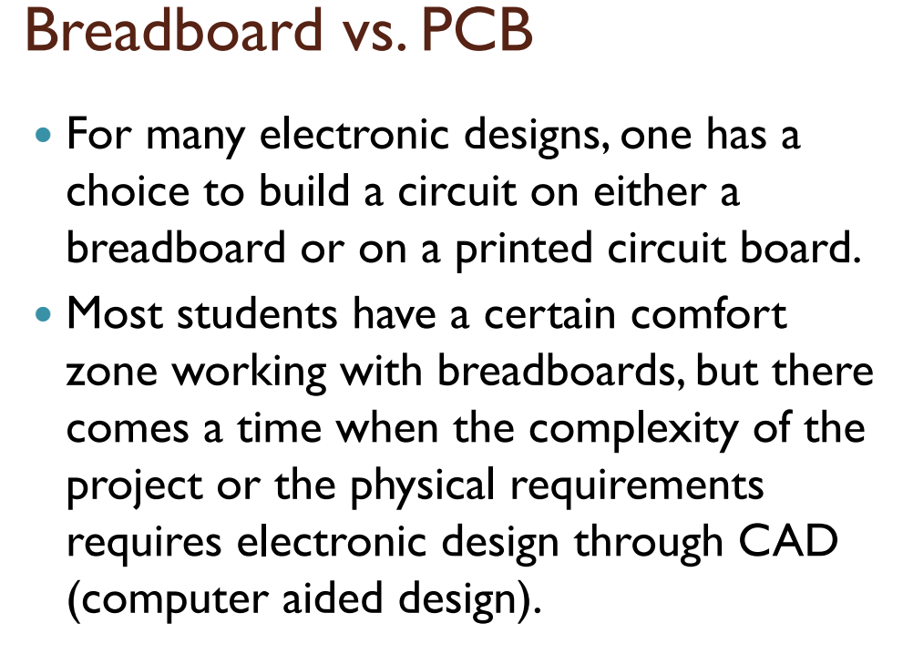

Slide 4
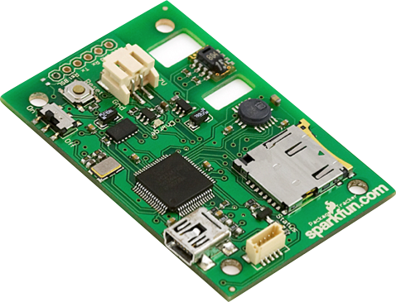
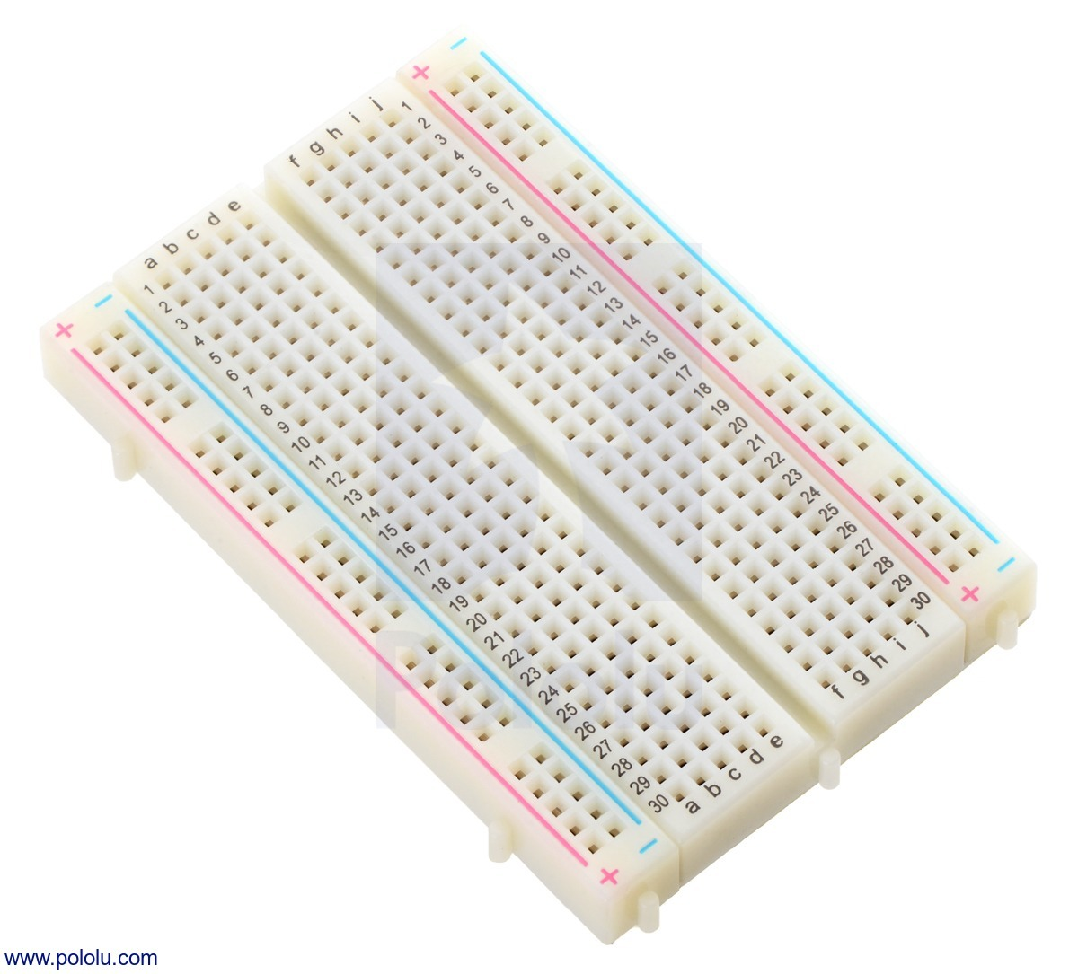

Slide 5
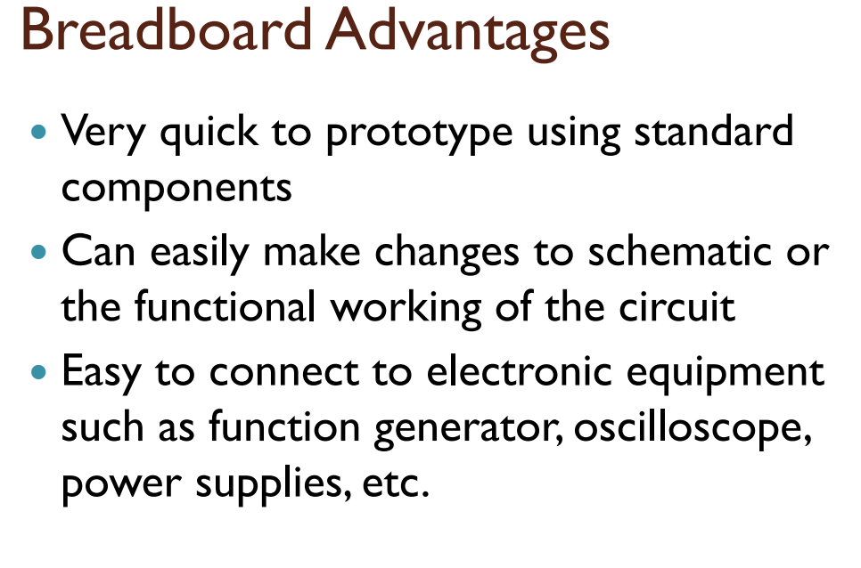

Slide 6
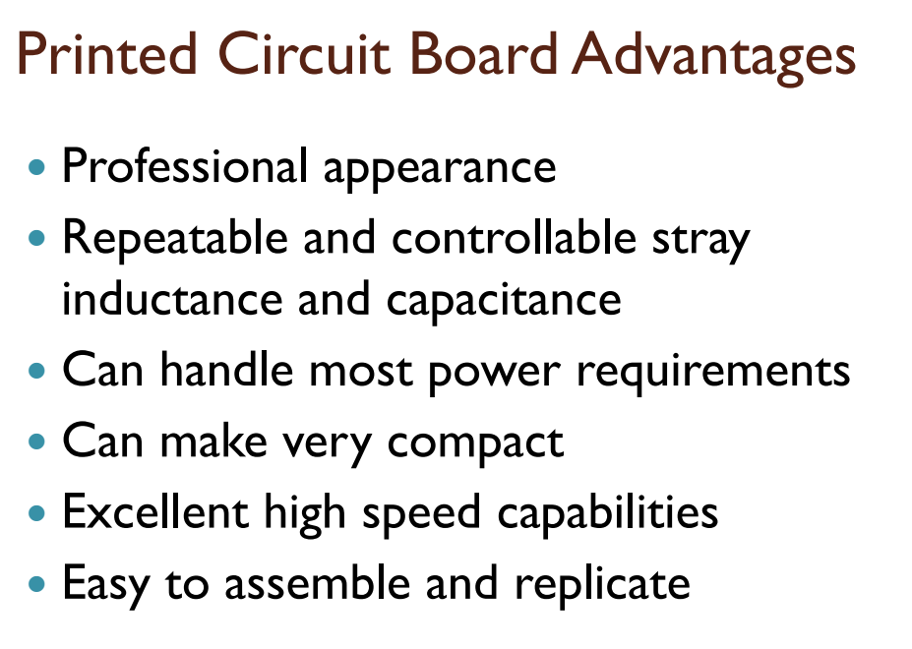

Slide 7
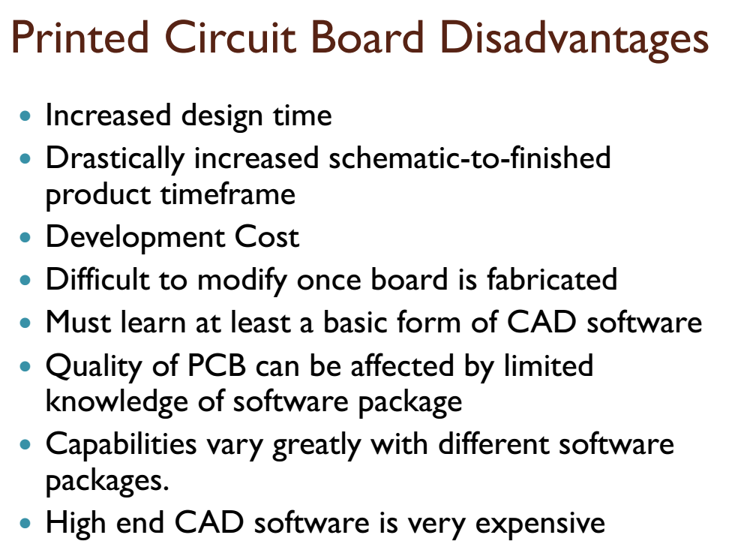

Slide 8

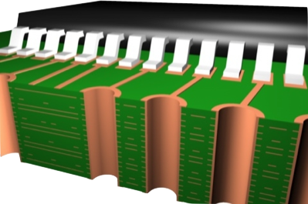
What is a PCB?
Layers, Traces, Planes, and Vias

Slide 9



Component Suppliers
Where do we get the goods?
For the “weird & wonderful” -
For the “inexpensive everyday” -
For the board itself -
www.mouser.com

Slide 10
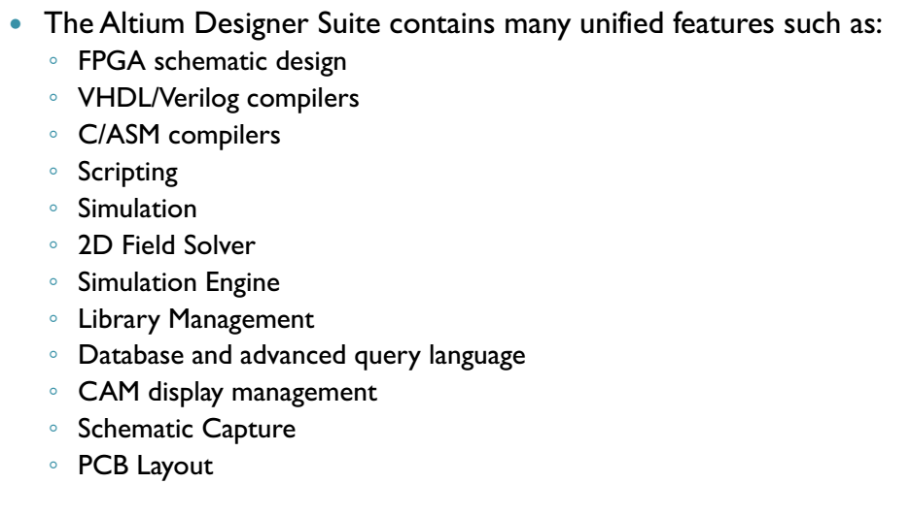
Altium Designer

Slide 11
The PCB Design Process
From Vision To Reality
Schematic Capture
Place Components
Iteration
Route Traces
Generate Gerbers

Slide 12

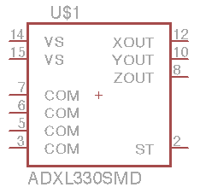
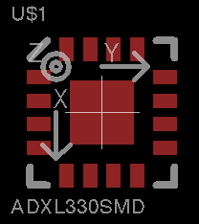
Eagle PCB
Symbol + Footprint + Device = Component
Symbol
Sym
Footprint
Pac
Device
Dev

Slide 13
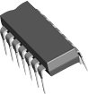
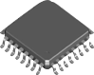

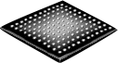
Place Components
Beware of physical fit
Actives - lots of packaging alternatives
But before you do ...
Thru-Hole (TH)
Surface Mount (SMT)
DIP
LQFP, QFP, TQFP
QFN
BGA

Slide 14
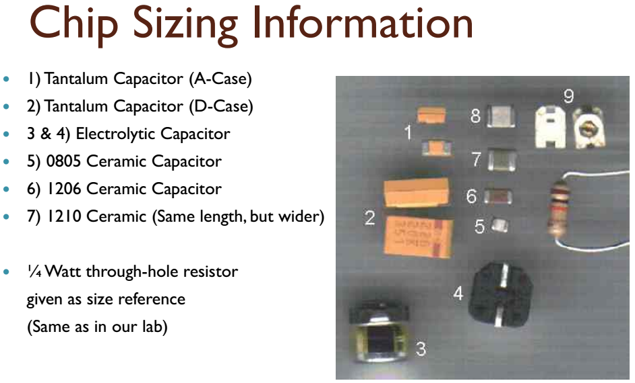

Slide 15
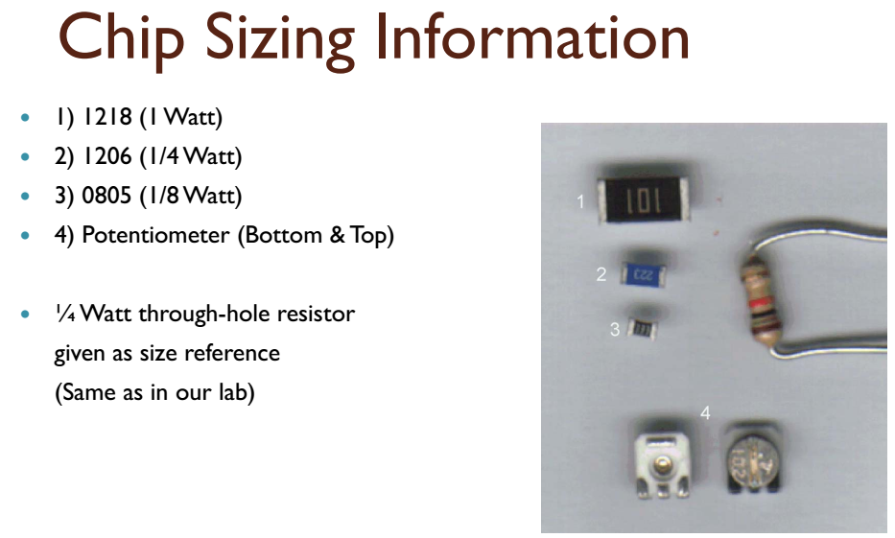

Slide 16
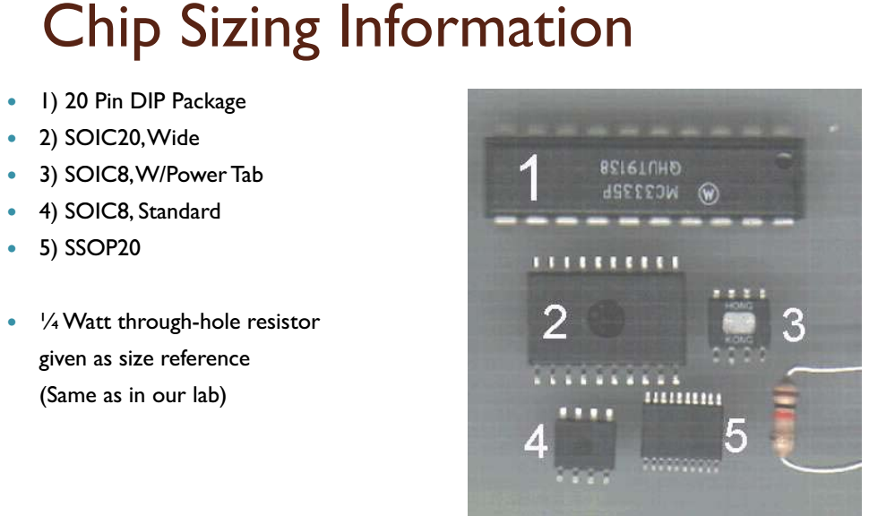

Slide 17
Altium Designer
Creating New Project
Adding
Schematic
PCB

Slide 18
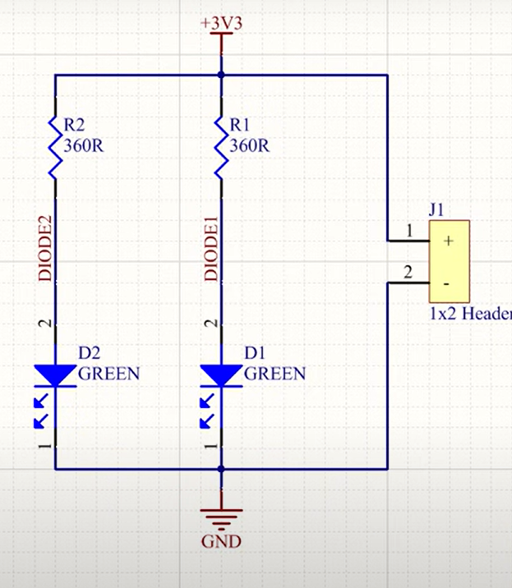

Slide 19
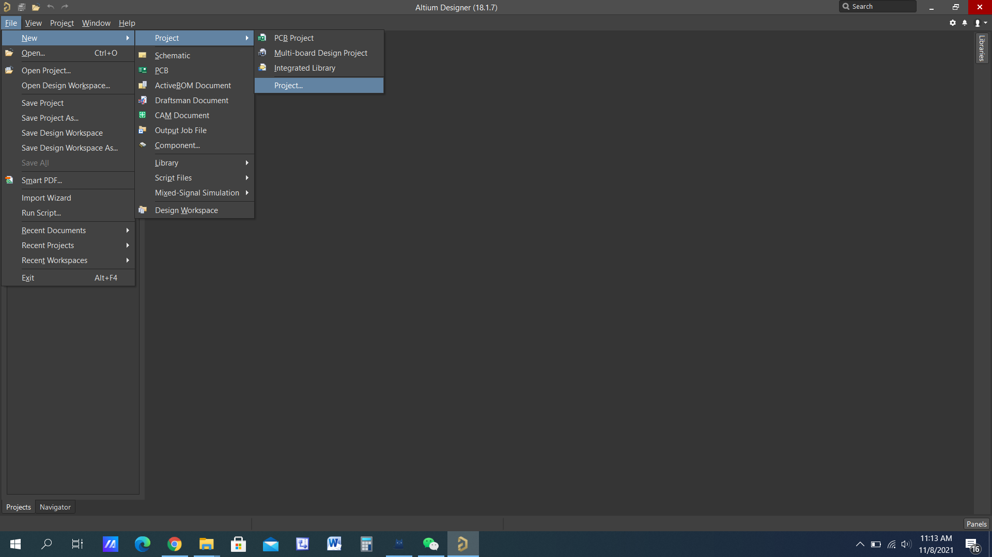
To start a new Project

Slide 20
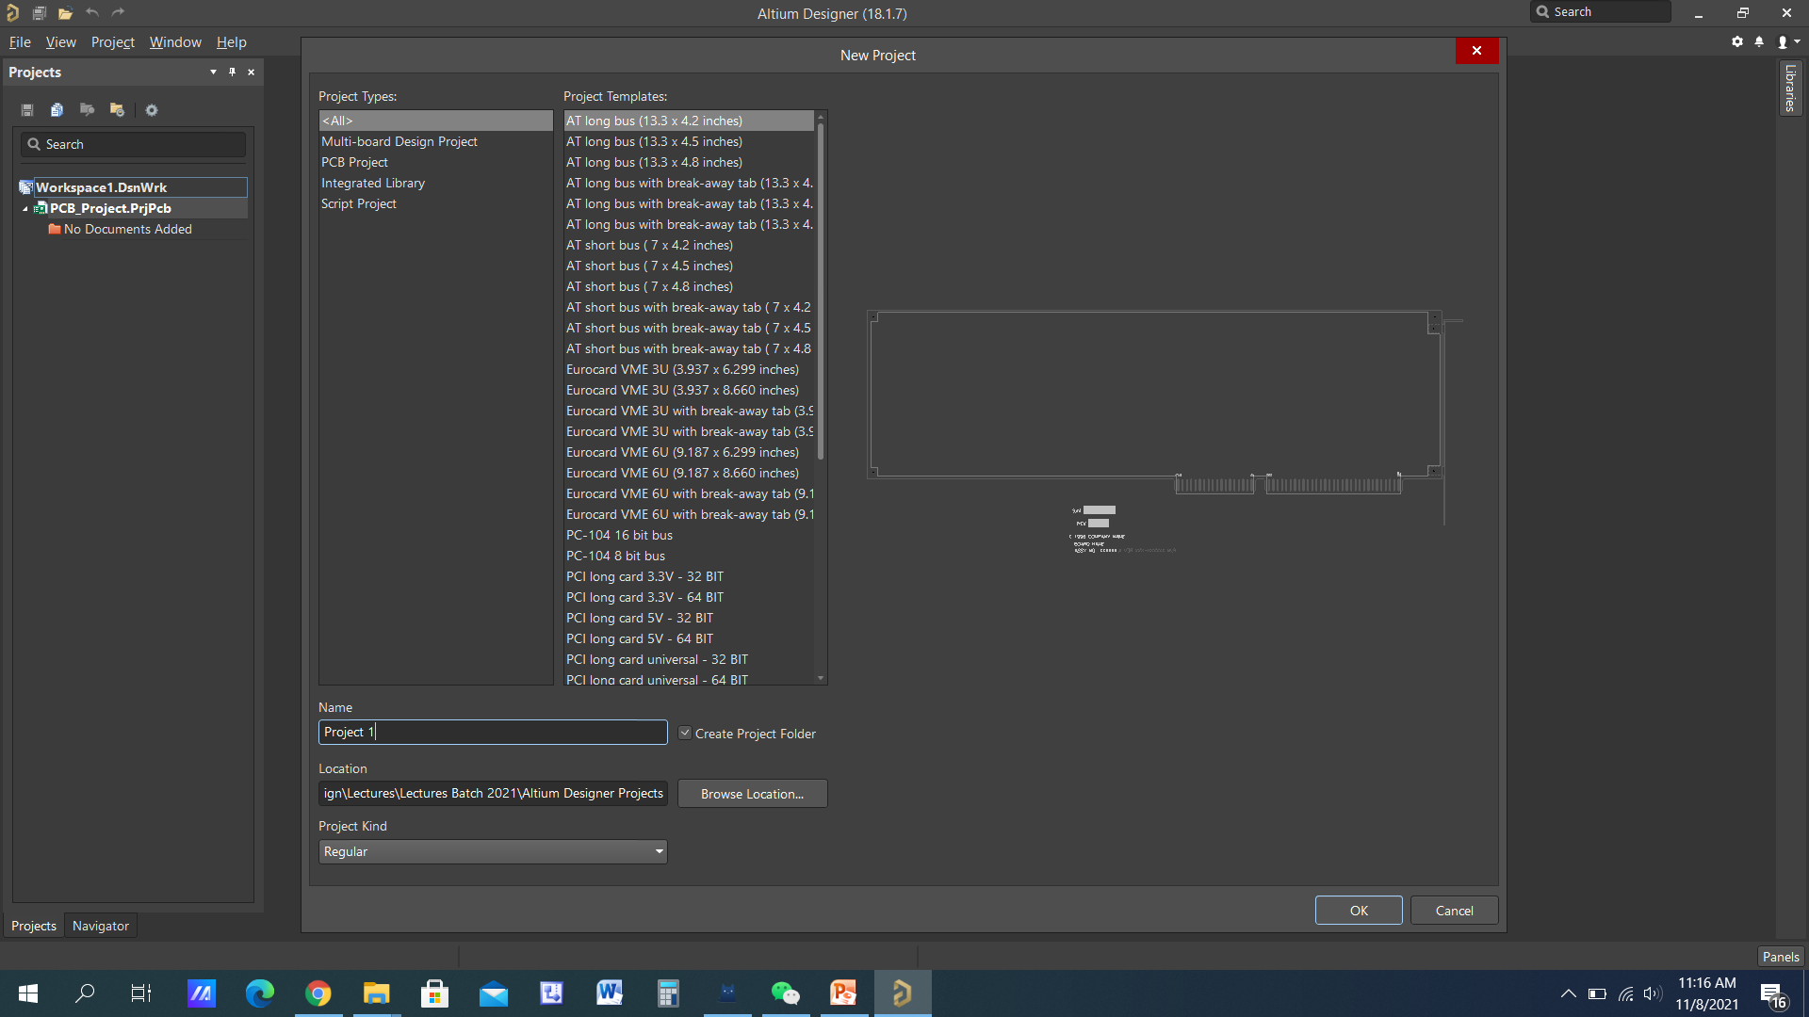

Slide 21
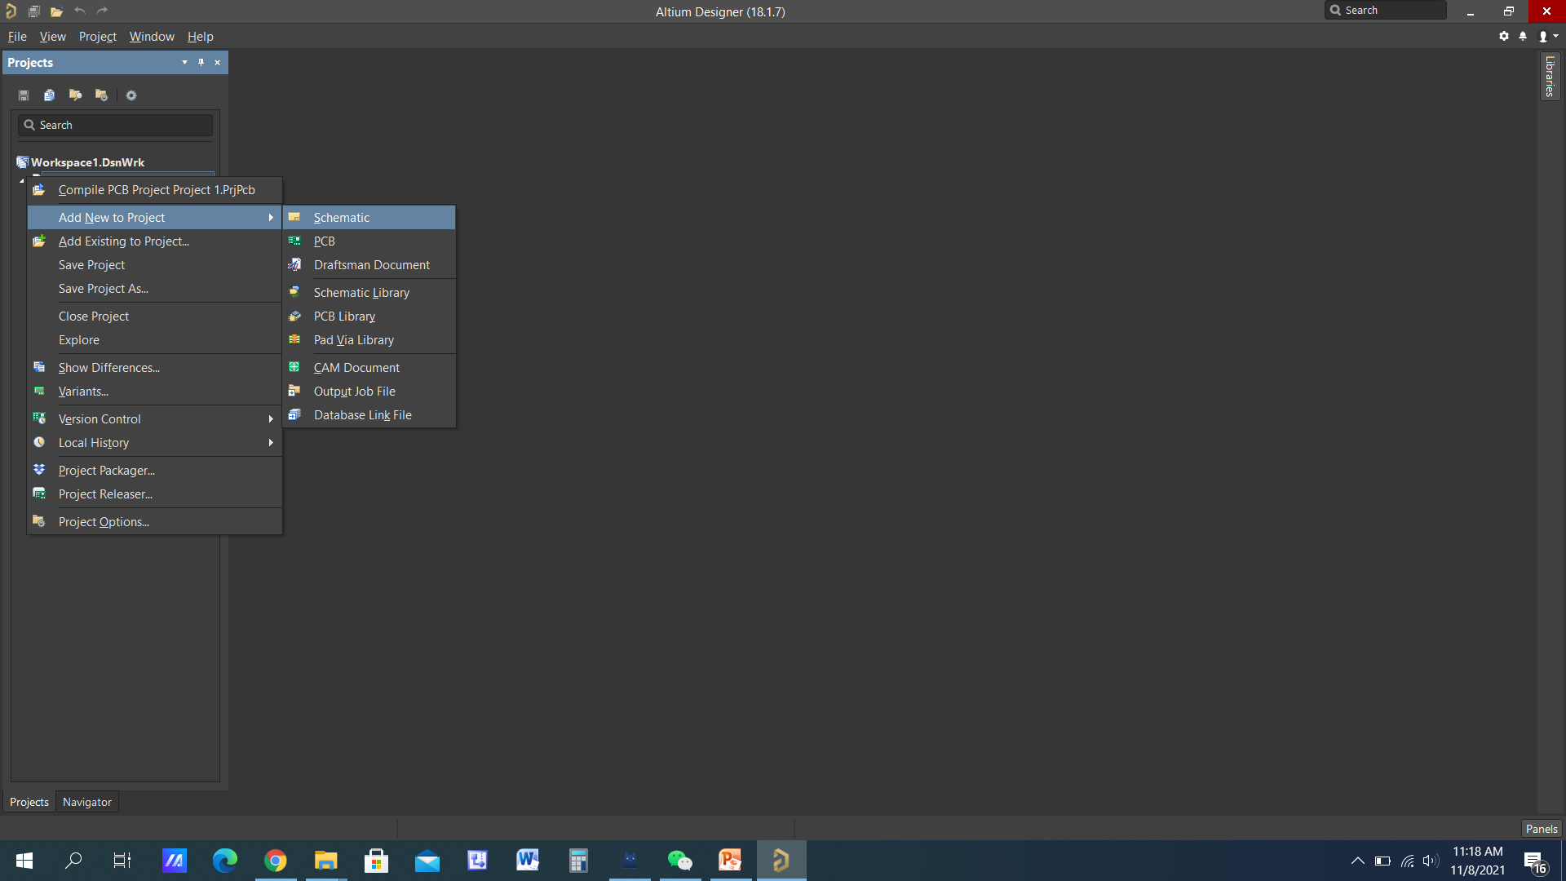

Slide 22
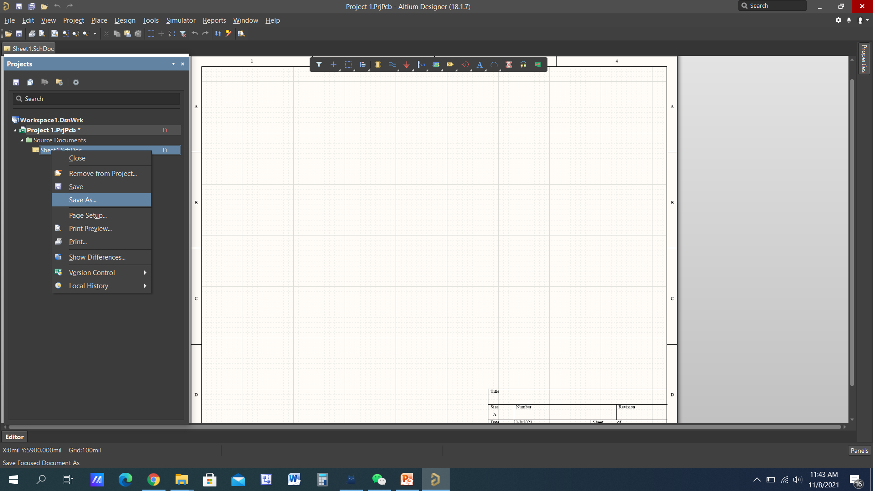

Slide 23
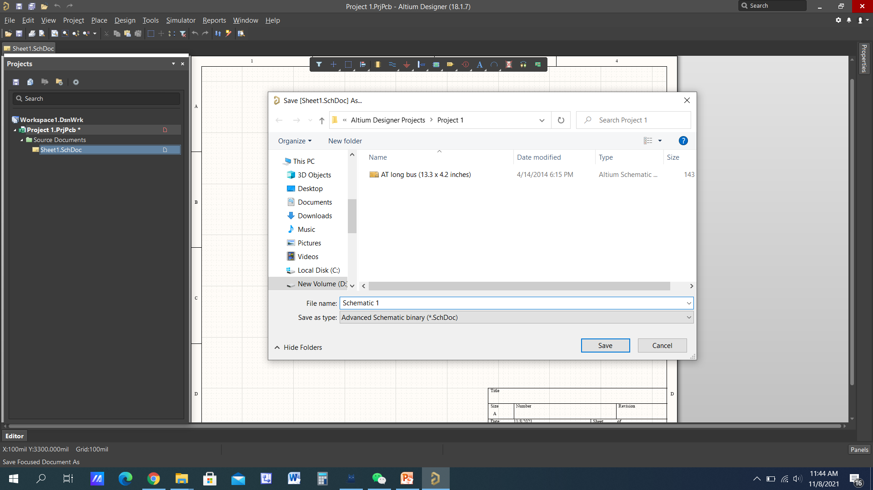

Slide 24
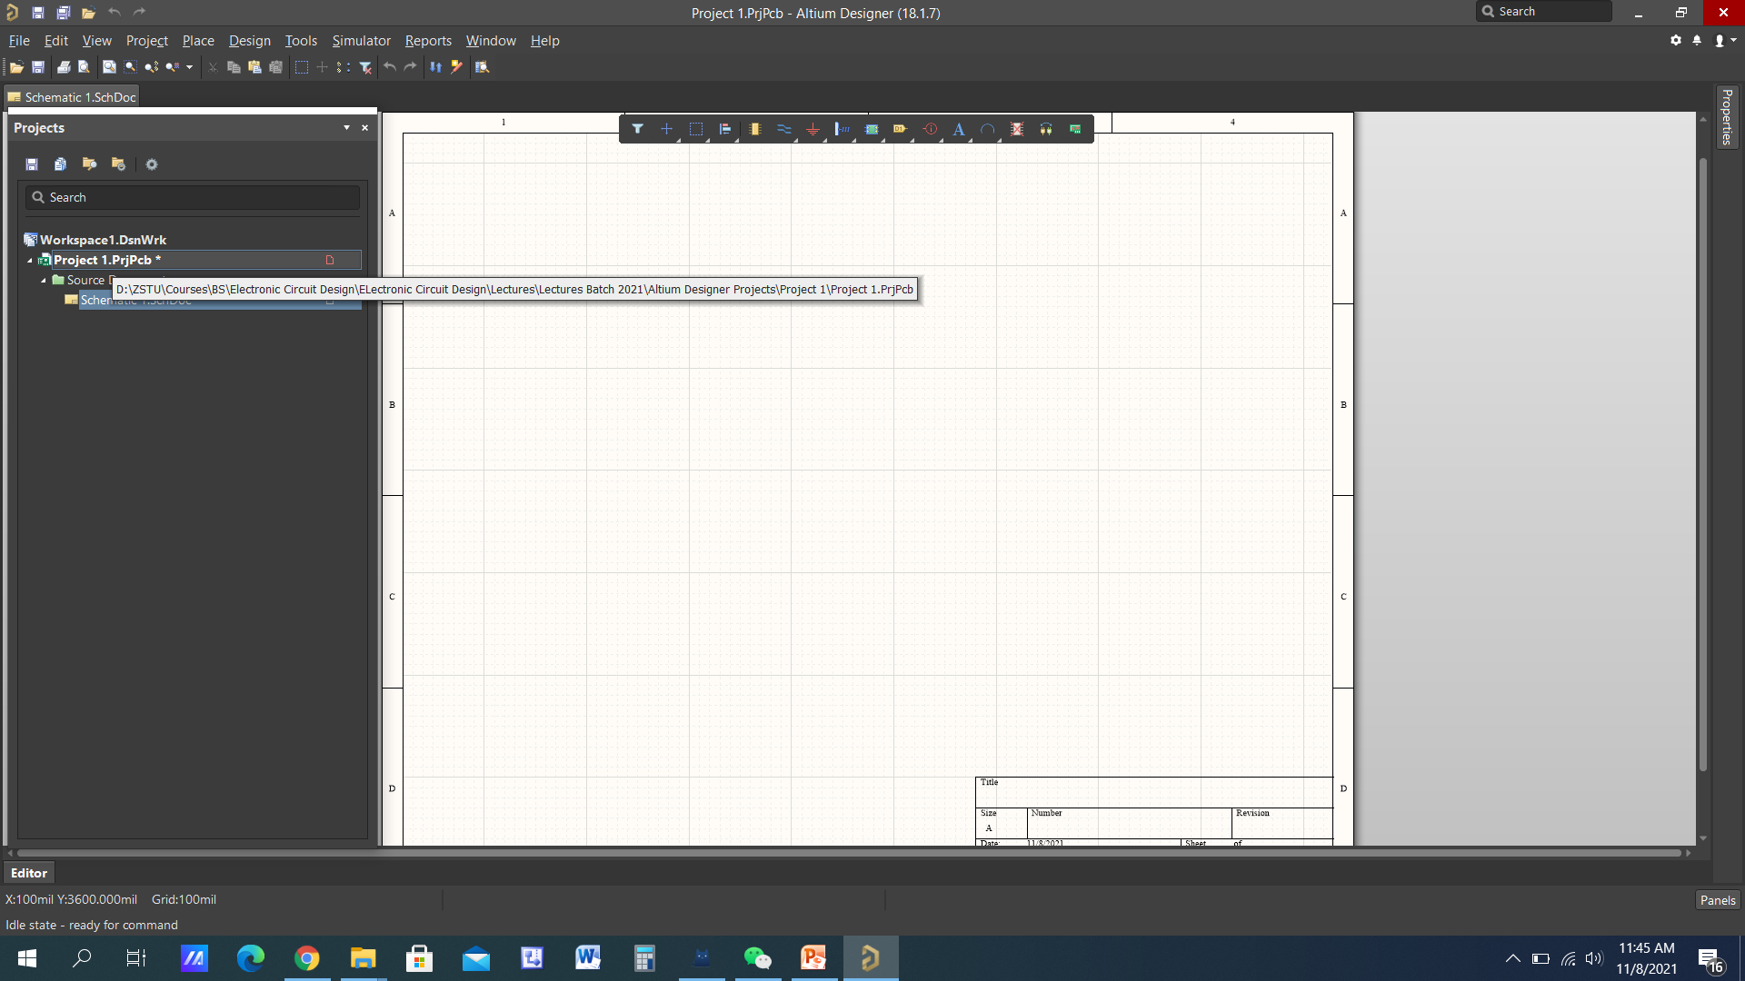

Slide 25


Slide 26
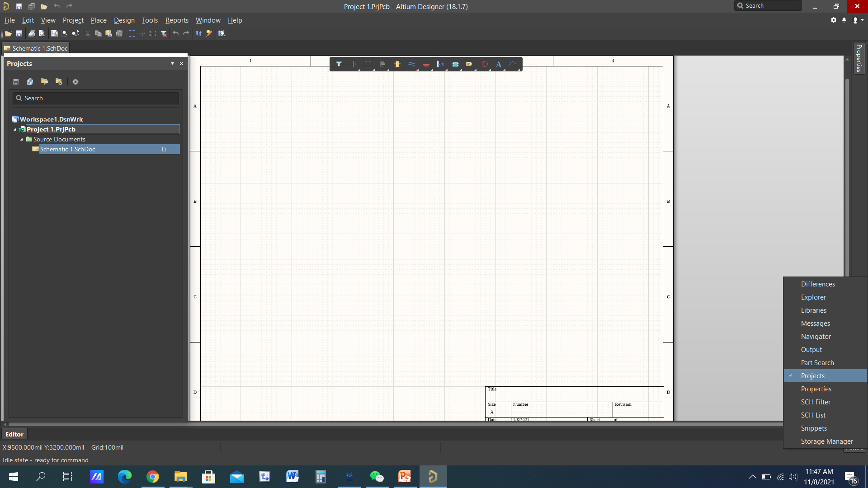
To see all possible panels

Slide 27
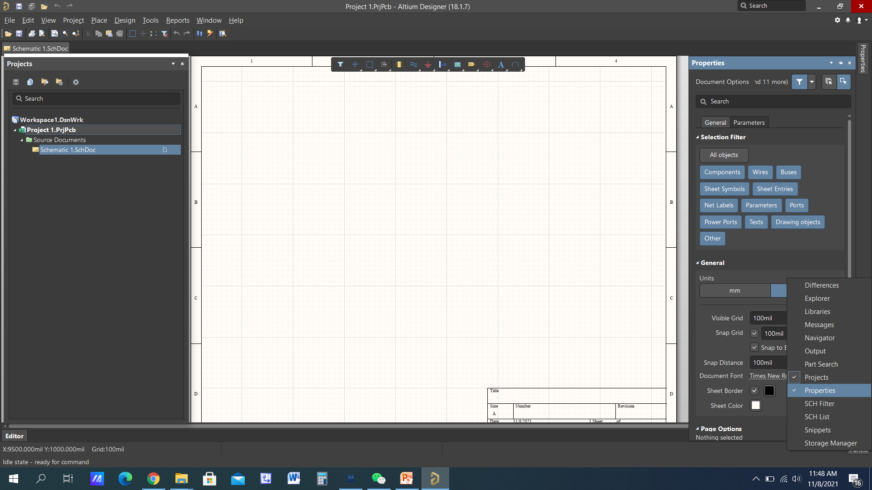
Also open the properties panel

Slide 28
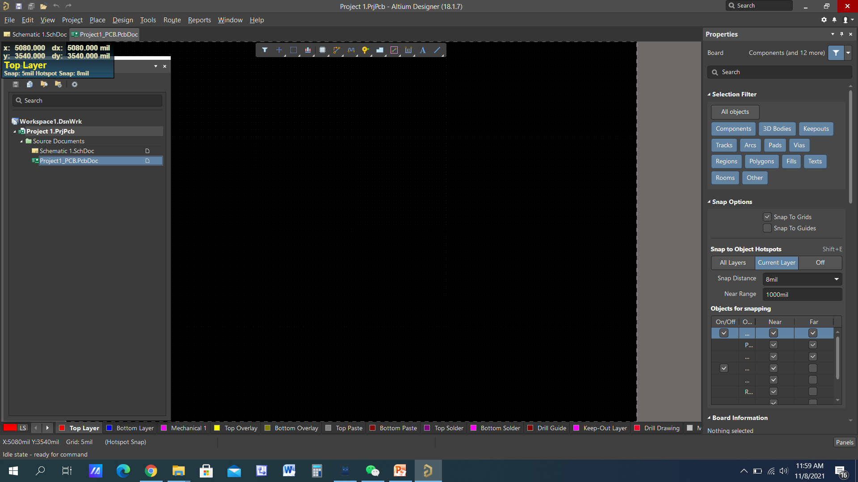
Add PCB to the Project

Slide 29
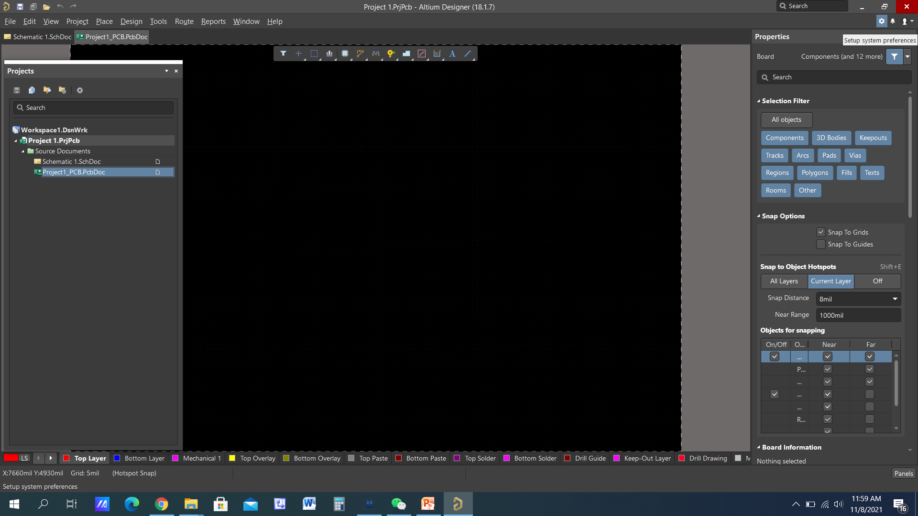
Setup Preferences

Slide 30
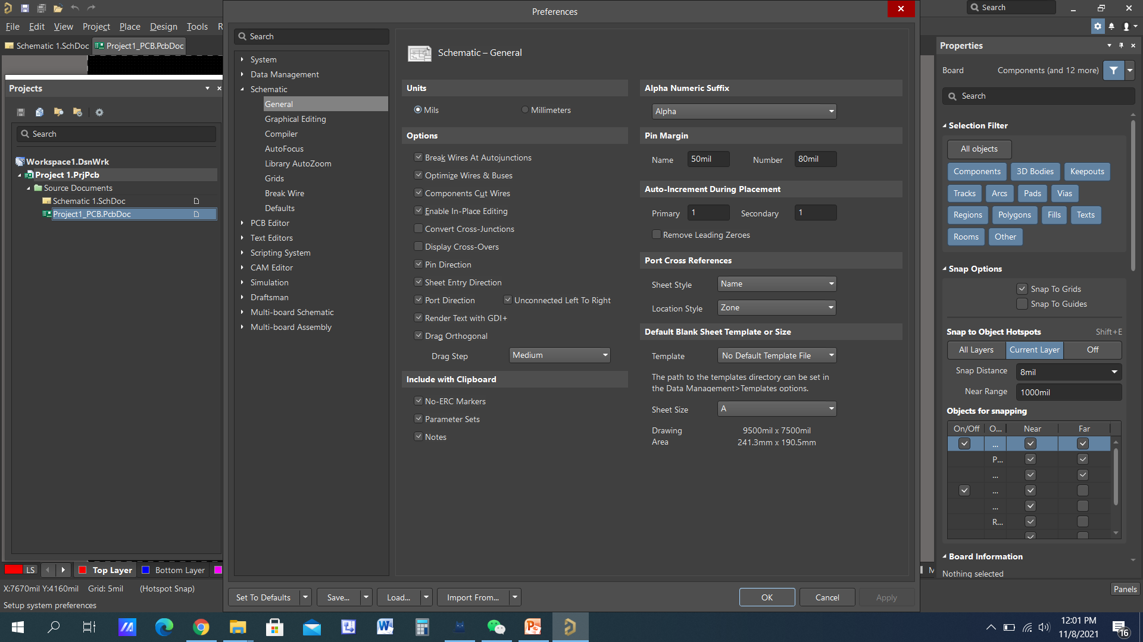
Setup Preferences

Slide 31
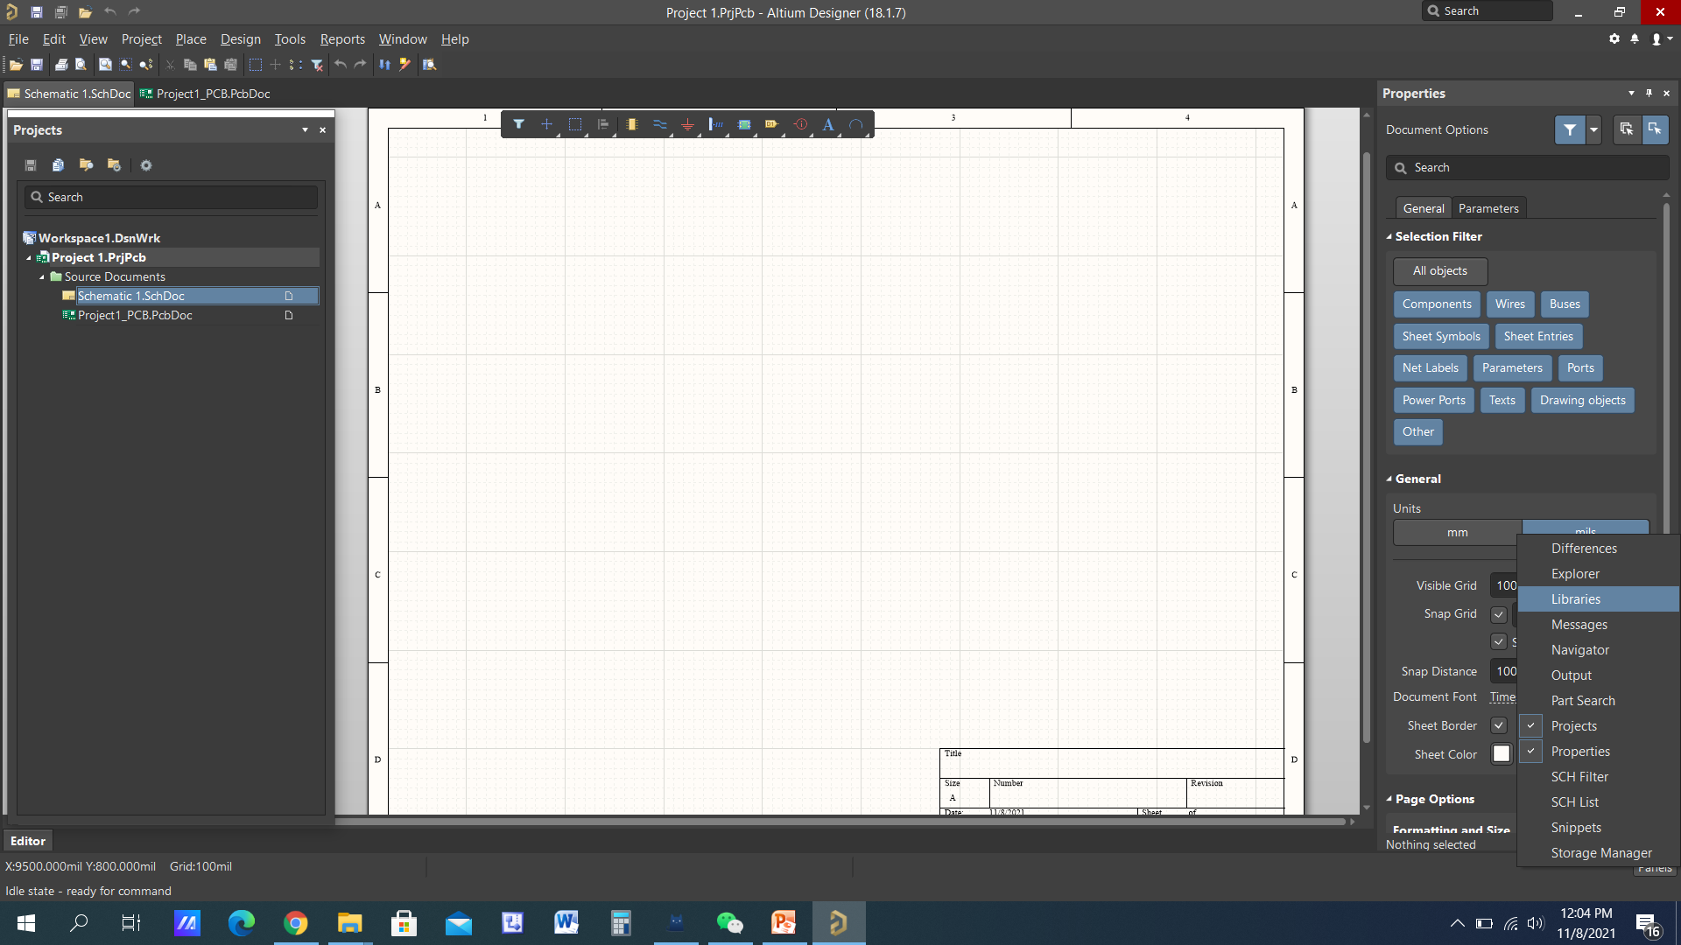
Libraries

Slide 32
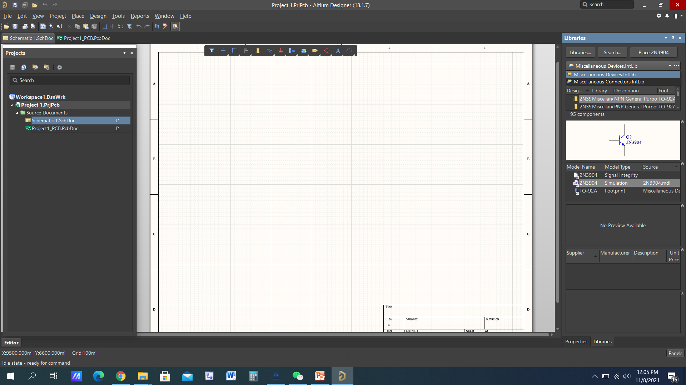
Libraries

Slide 33
Altium Designer
Schematic Capture
Placing Components
Connecting (wiring)

Slide 34
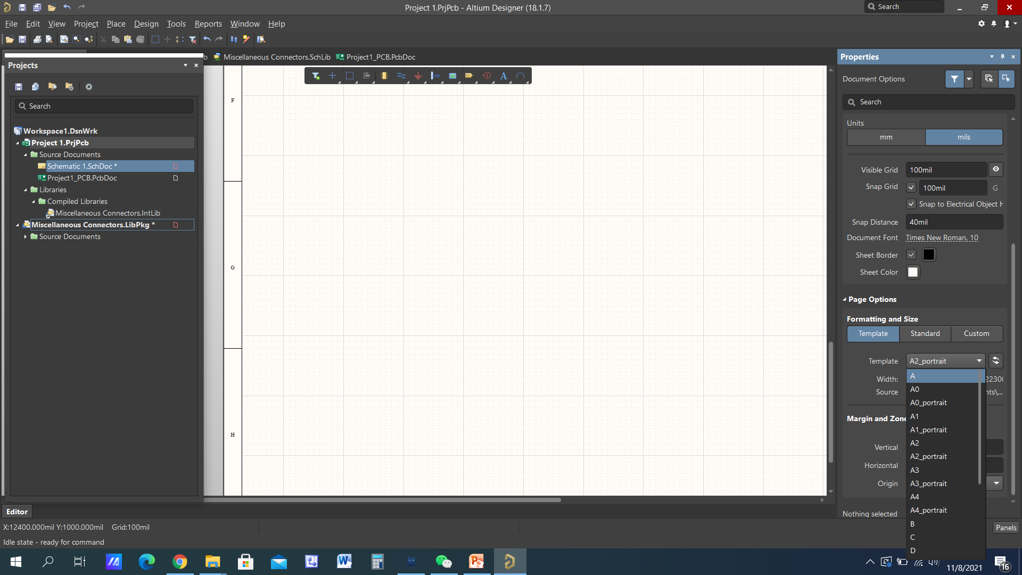
Sheet Size-Properties

Slide 35
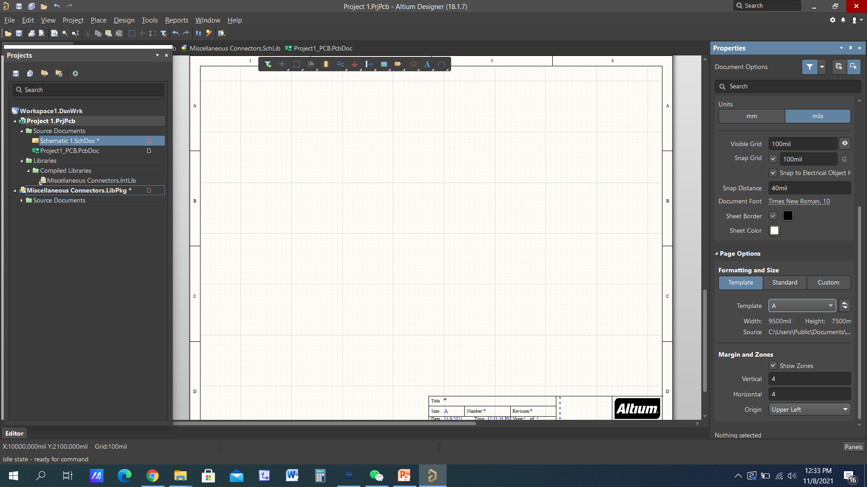
Sheet Size-A

Slide 36
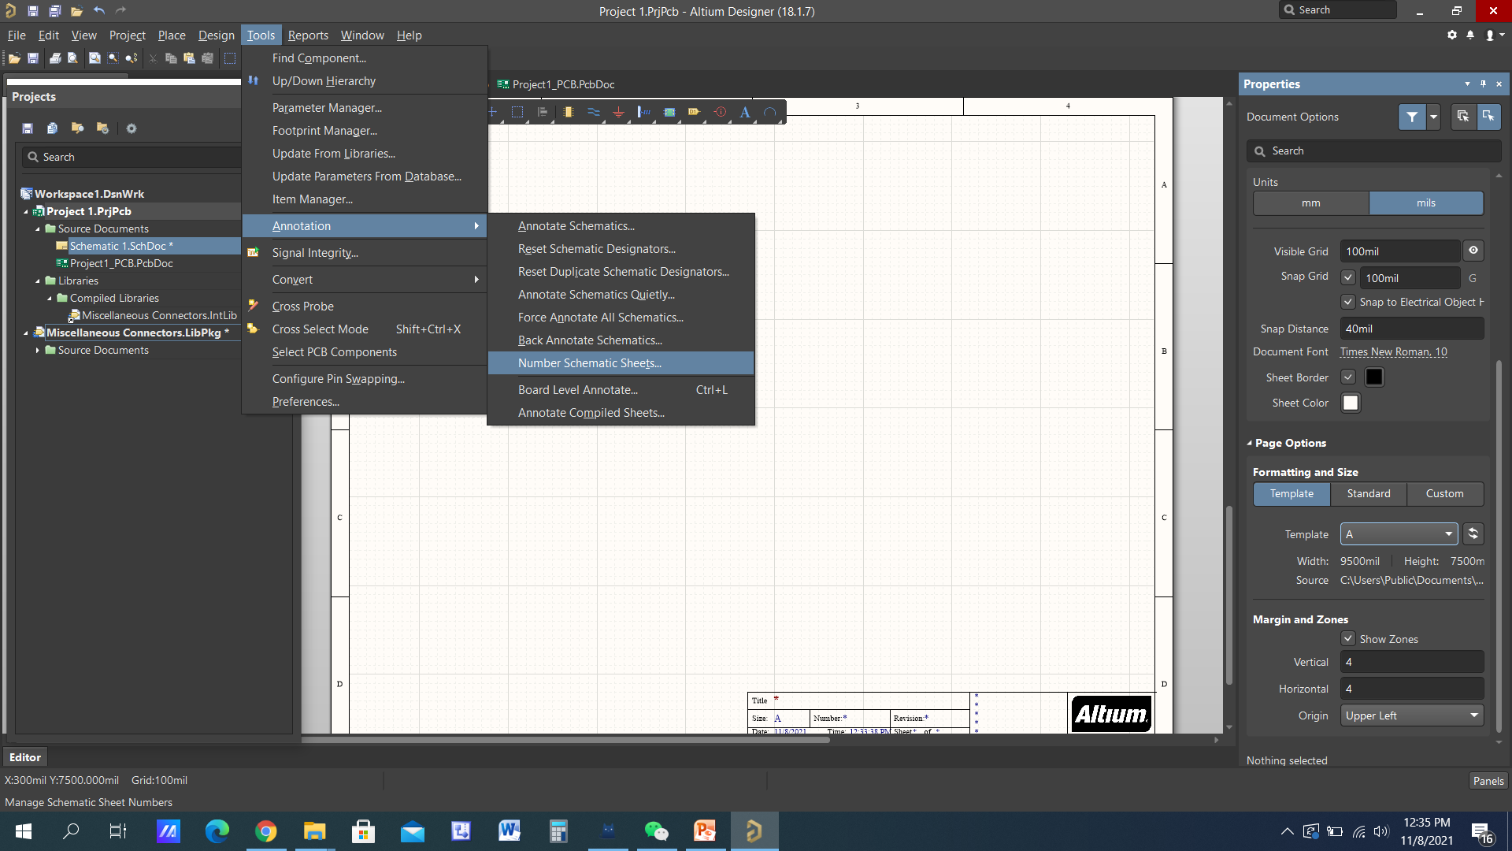
Assign Sheet Number

Slide 37
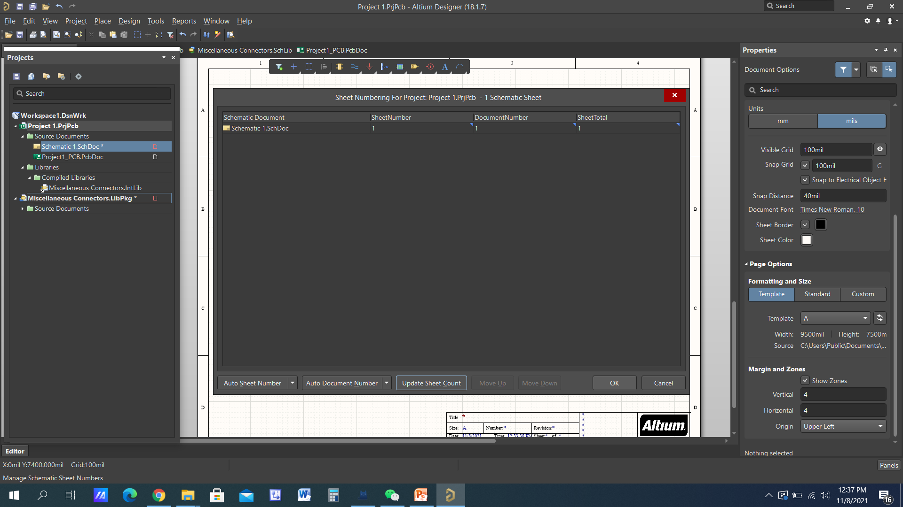
Click OK

Slide 38
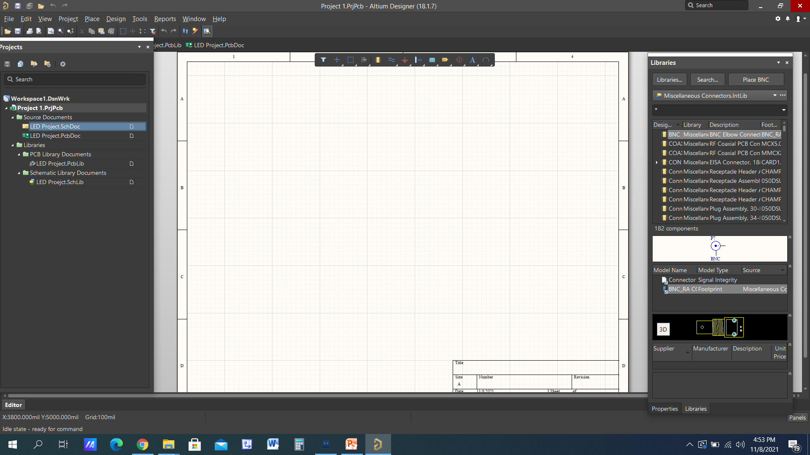
Add Schematic and PCB Libraries

Slide 39
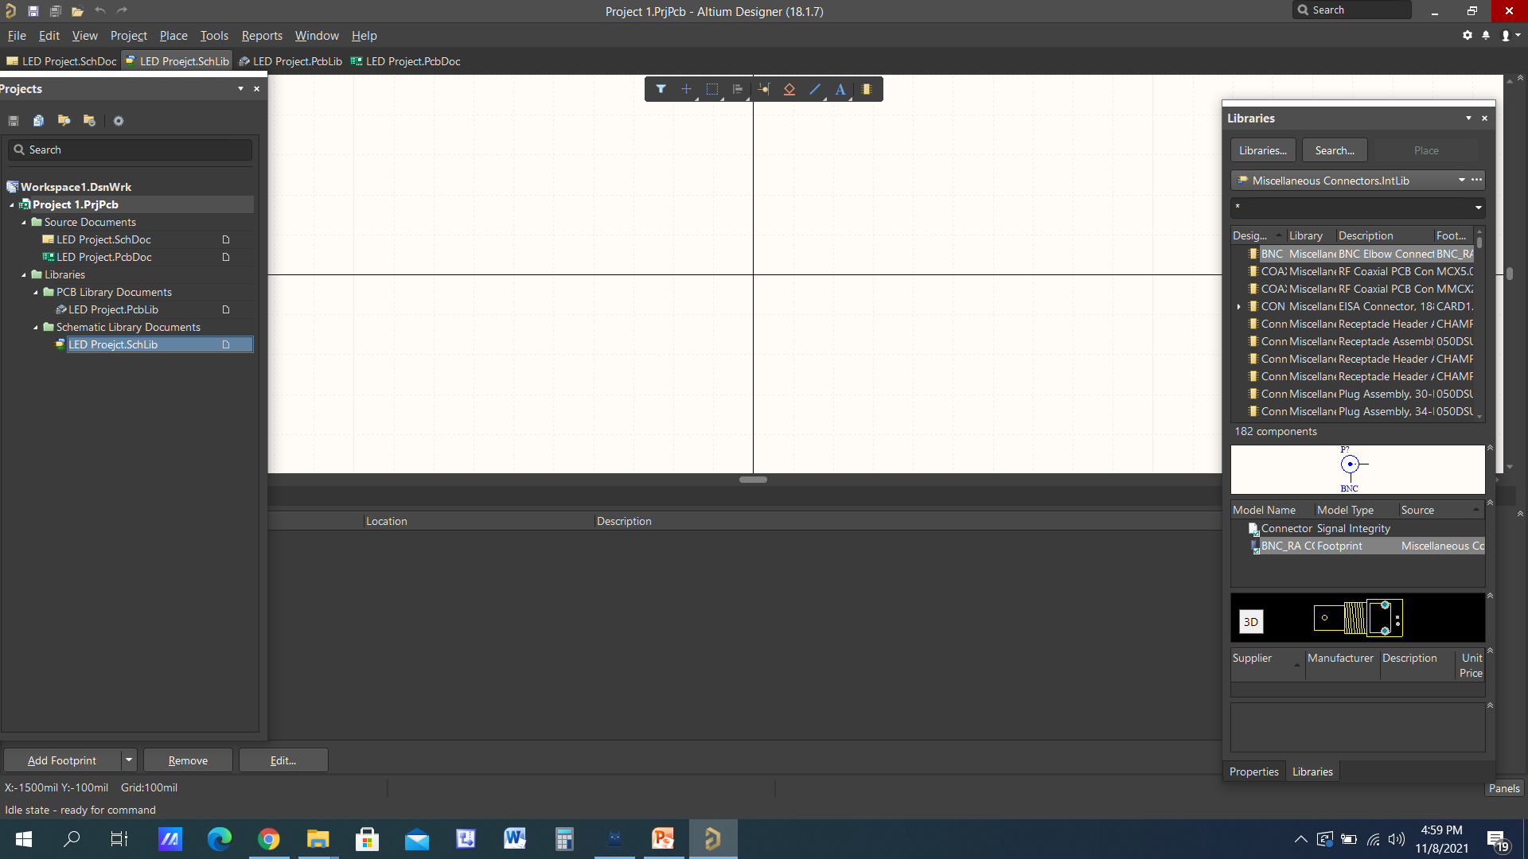
We are going to create our 1st Schematic Symbol

Slide 40
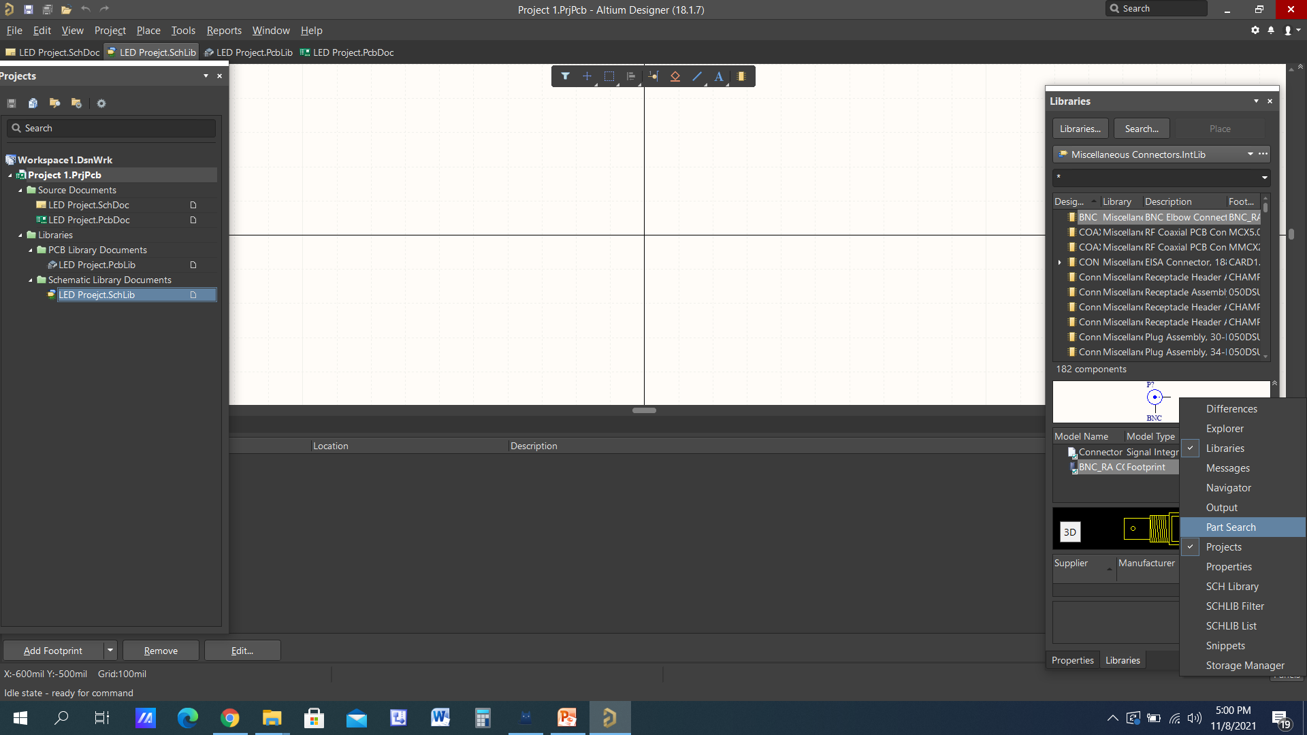
Part Search from the Panel

Slide 41
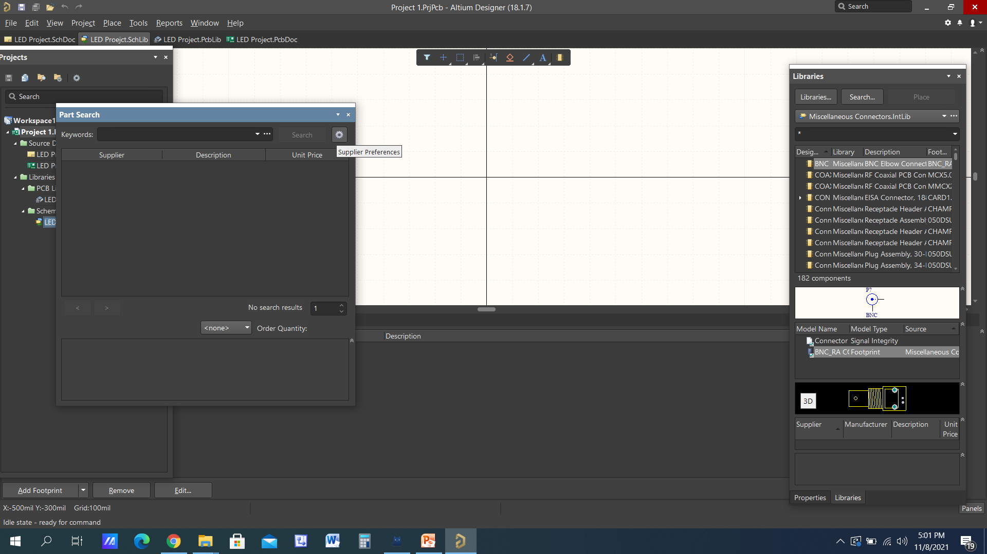
Supplier Preferences

Slide 42
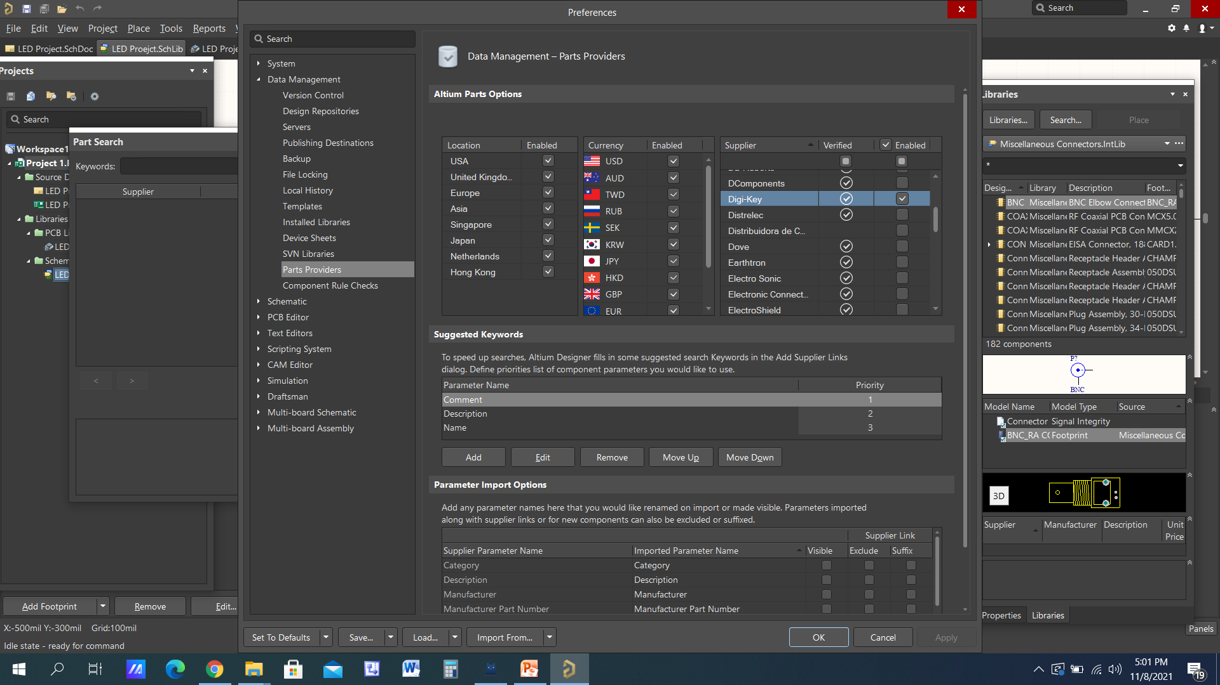
Select Digikey

Slide 43
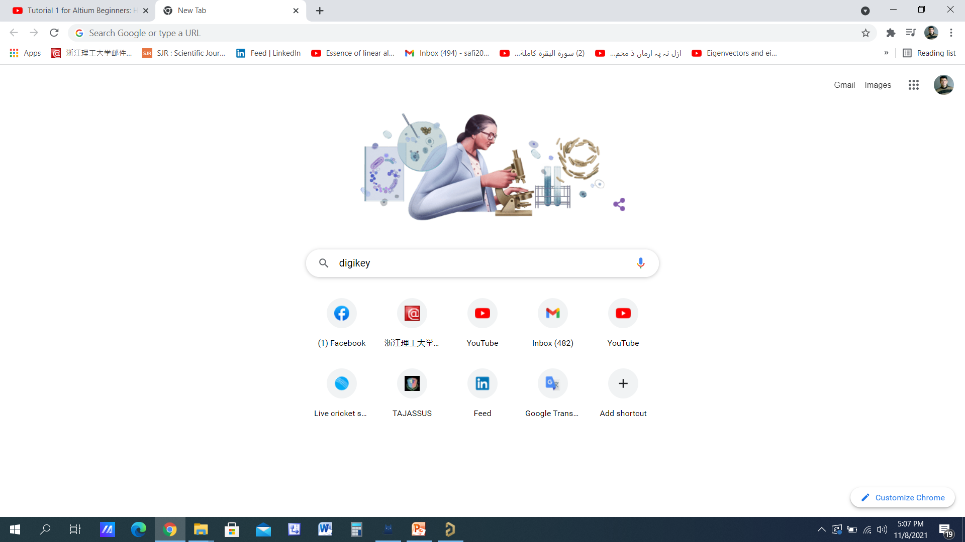

Slide 44
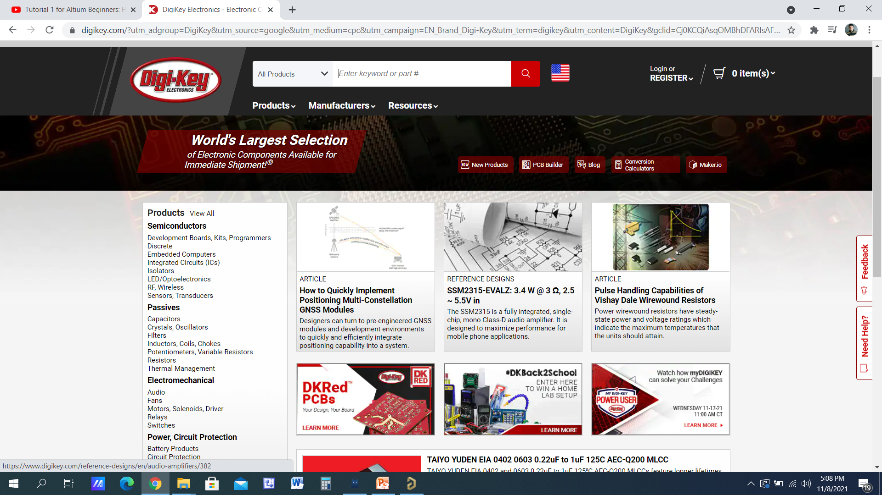

Slide 46
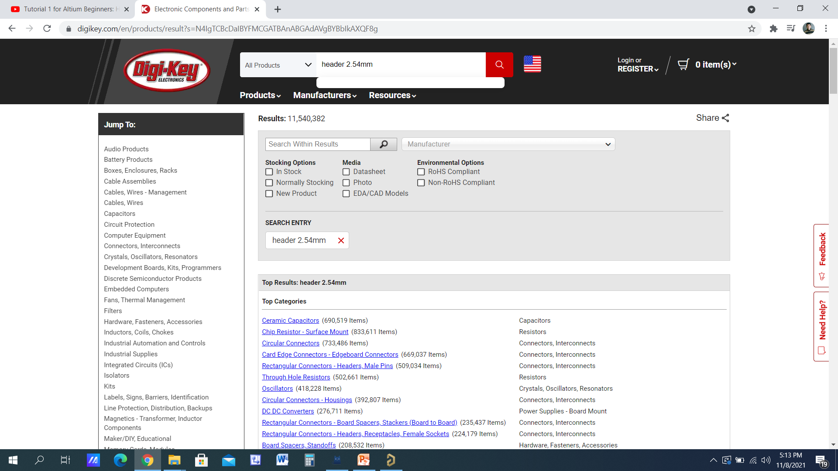
Header 2.54mm

Slide 47
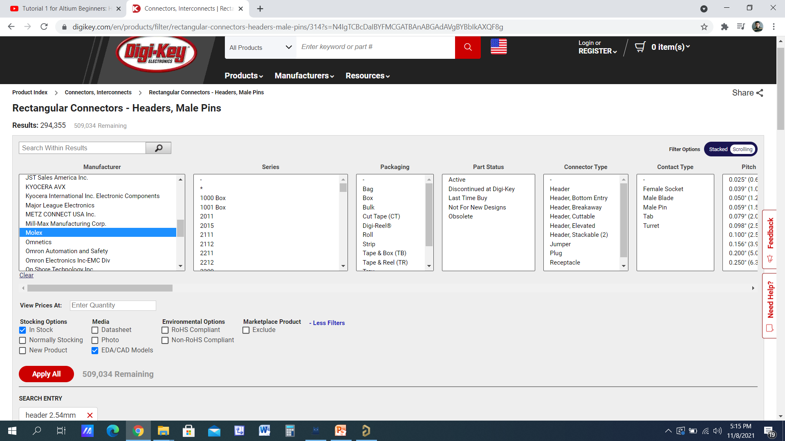

Slide 48
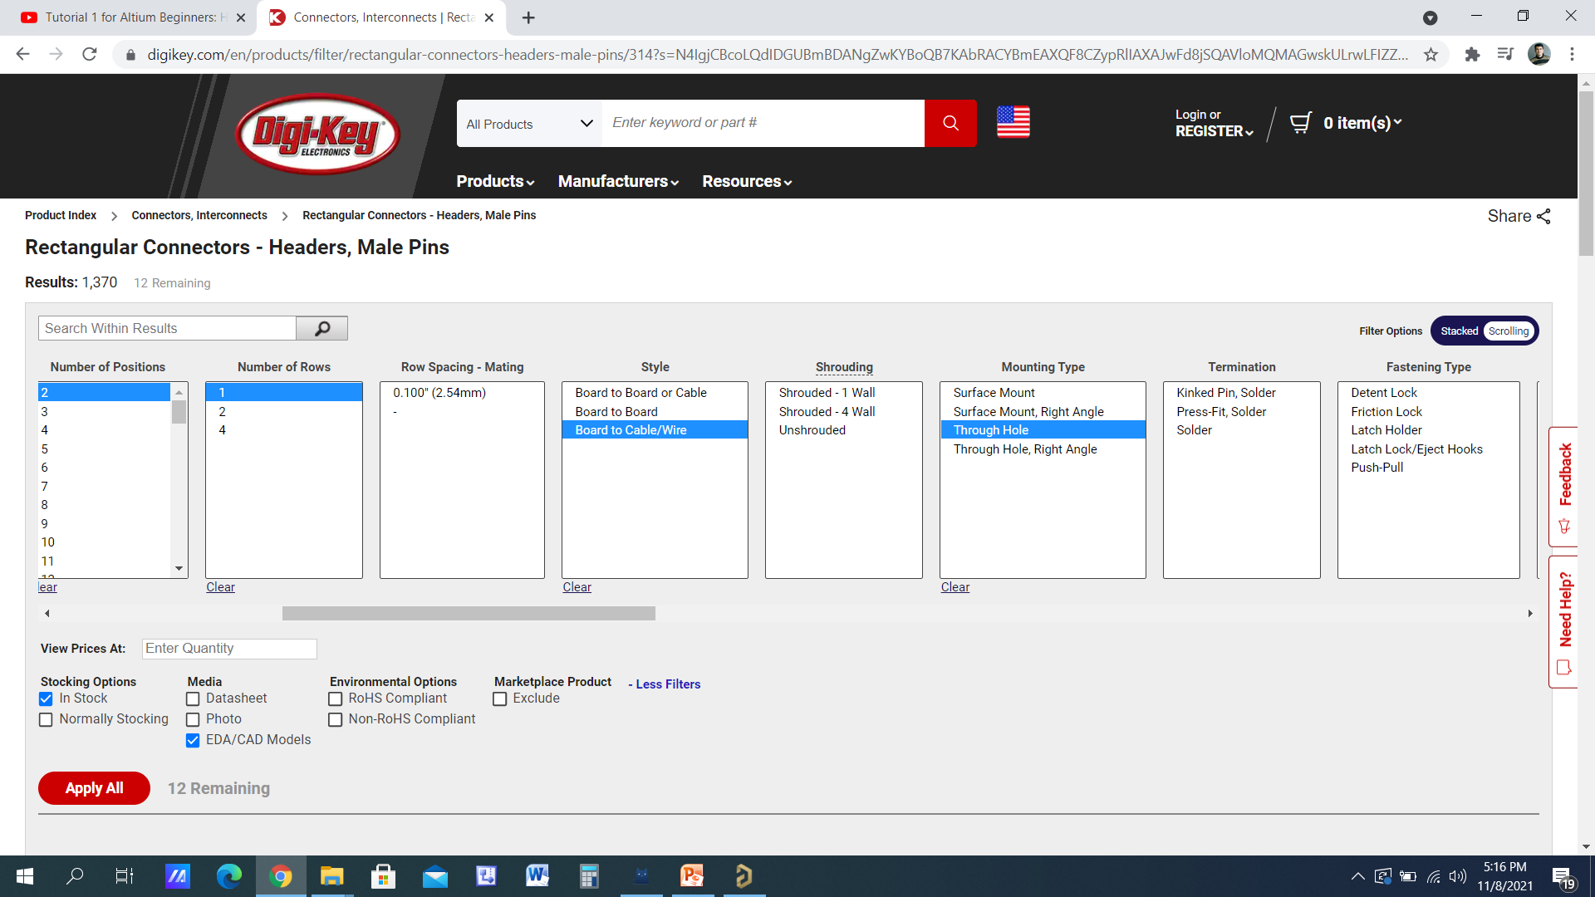

Slide 49
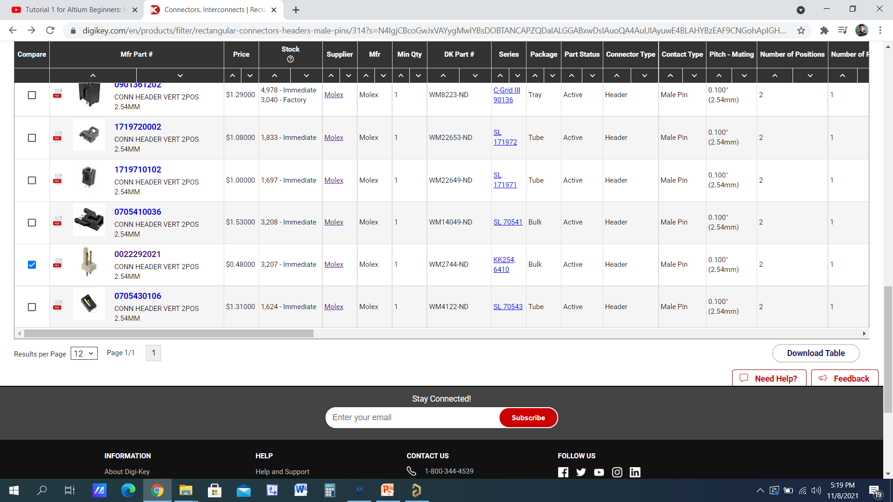

Slide 50
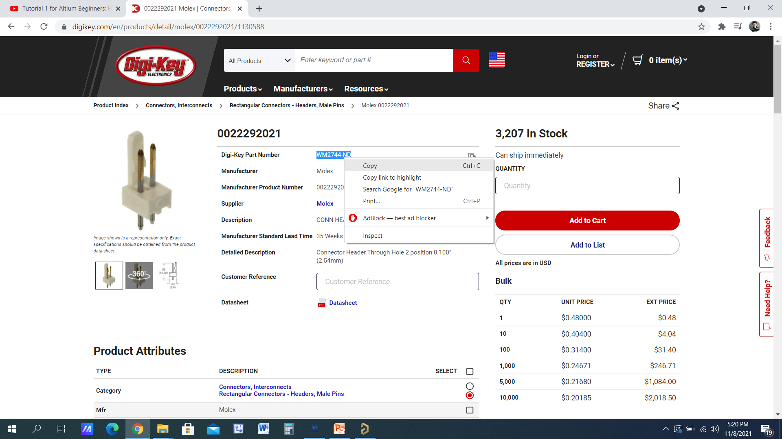

Slide 51
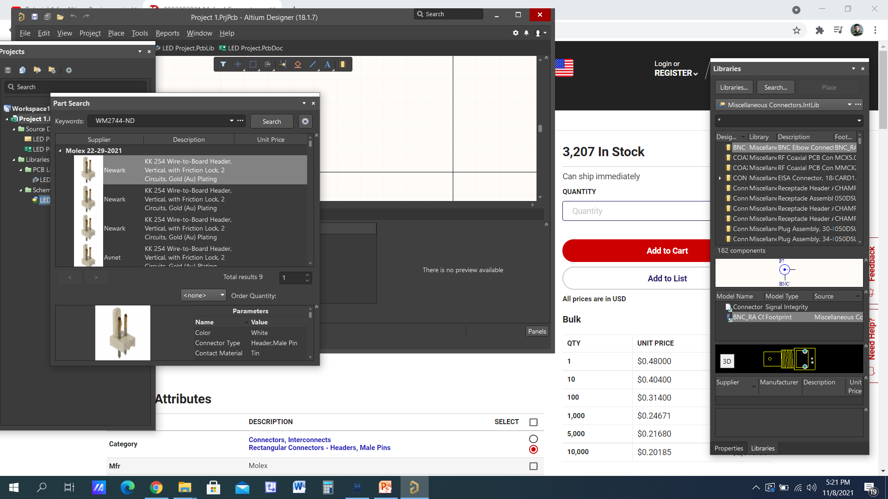

Slide 52
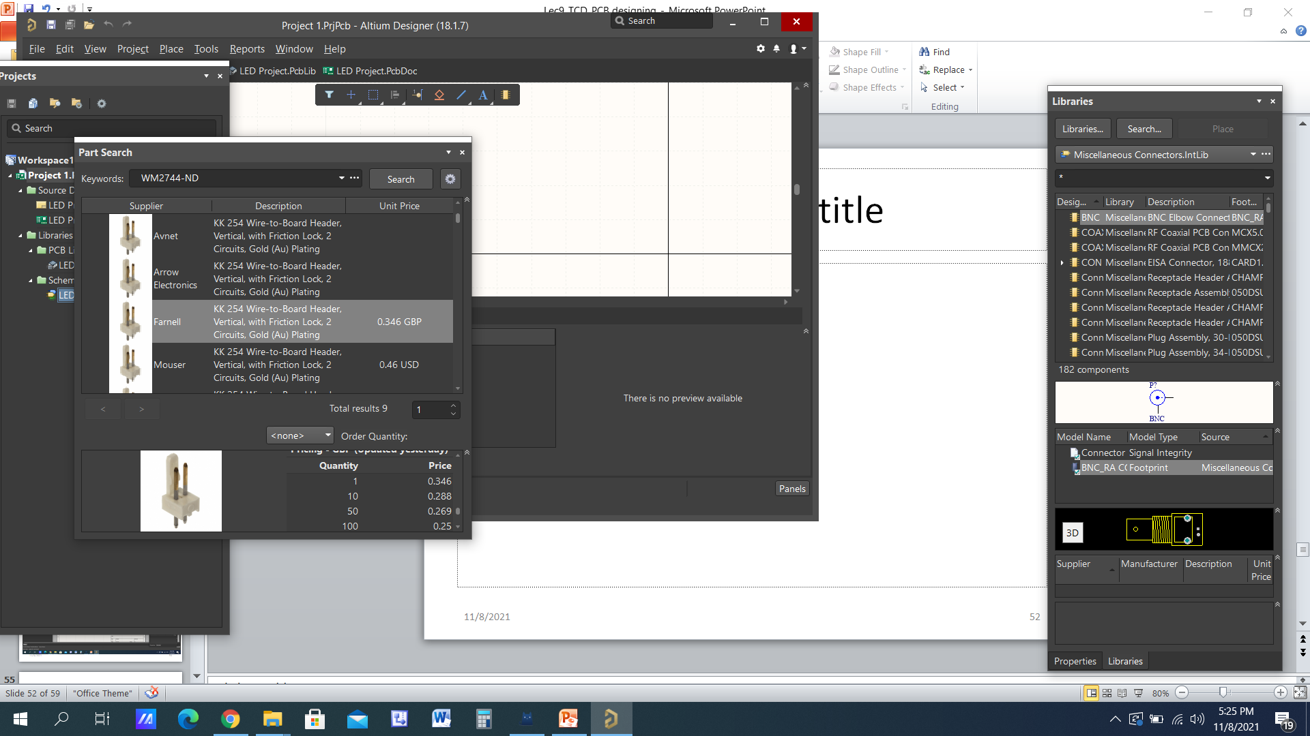
We can purchase it as single component

Slide 53
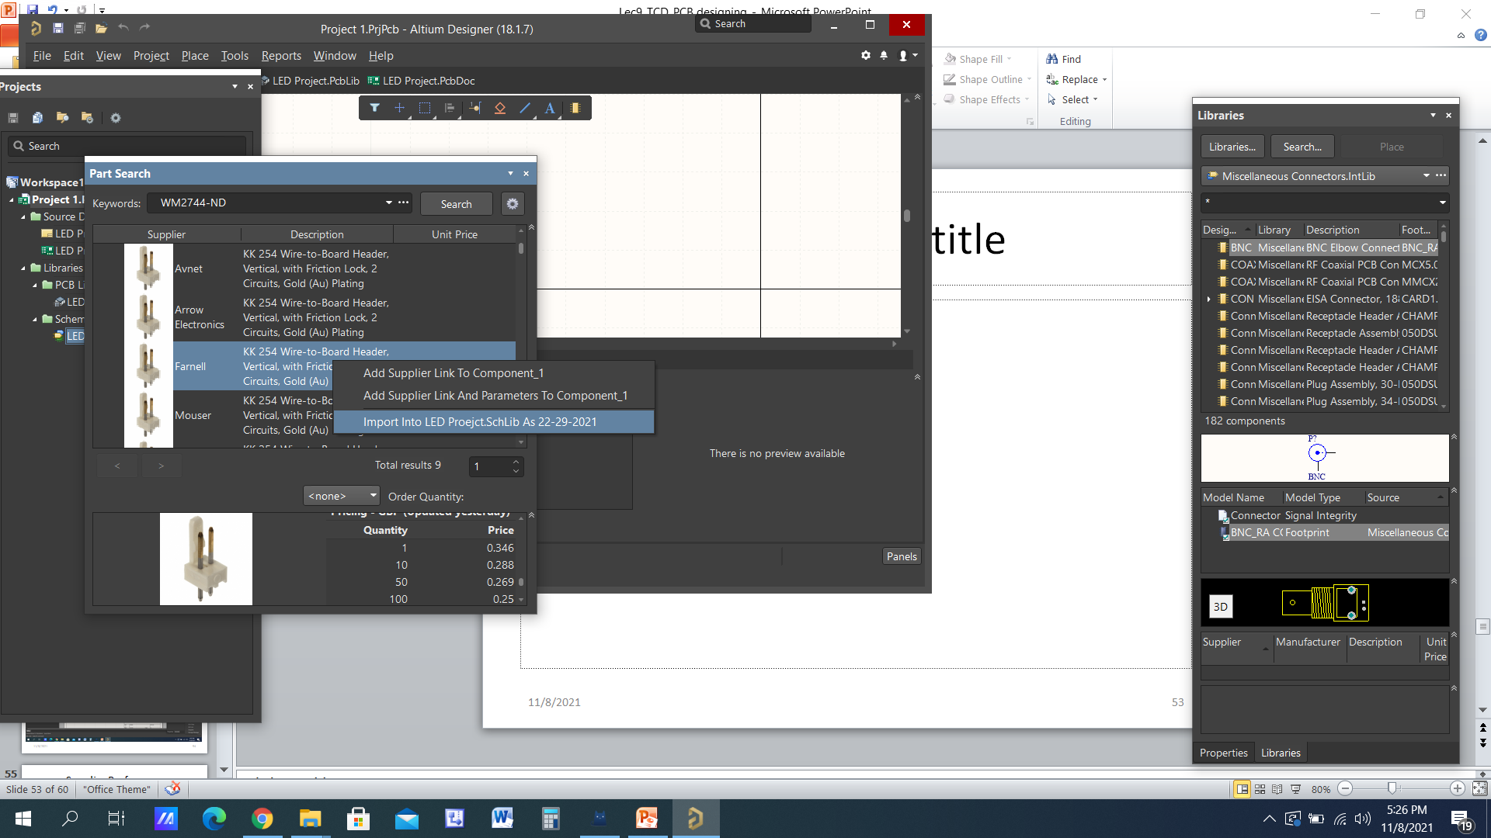
Import it

Slide 54
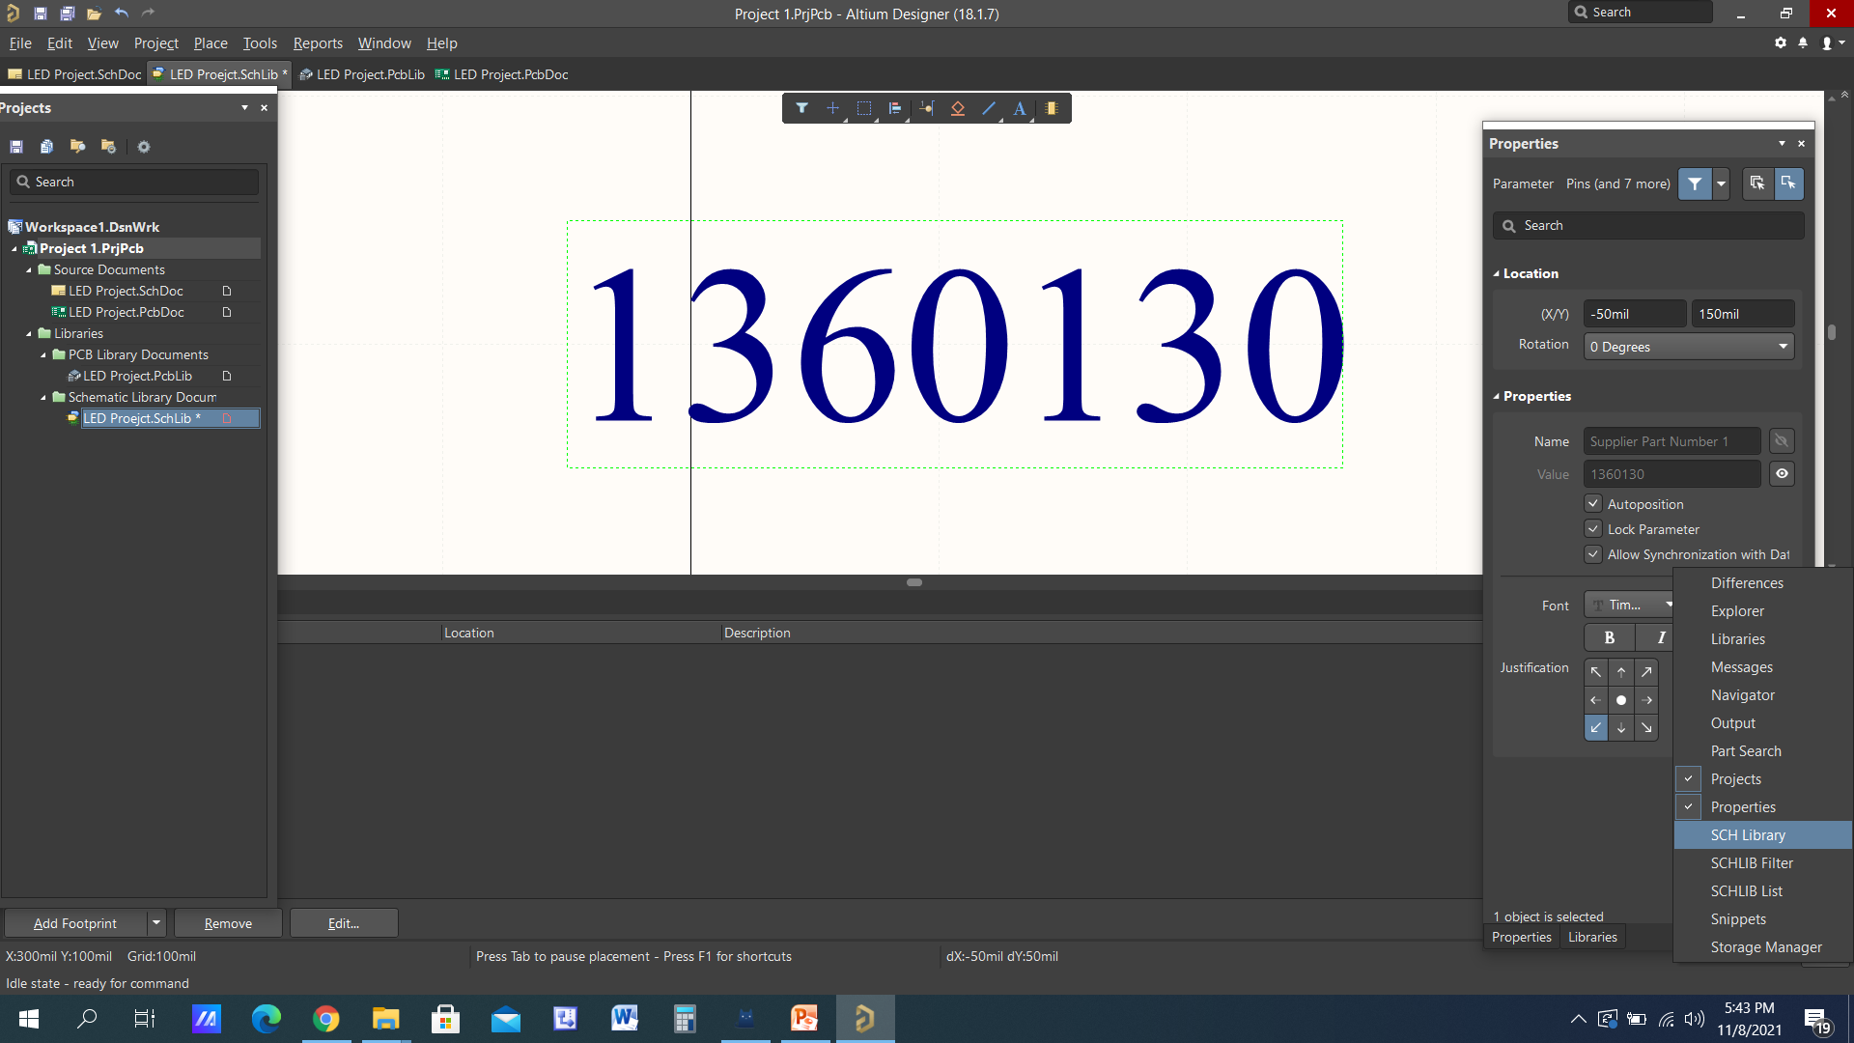

Slide 55

Hide the text

Slide 56

Place PINS
Select PIN from Place
Press Tab and change the PIN name and Reference designator

Slide 57


Slide 58


Slide 59


Slide 60


Slide 61


Slide 62


Slide 64

Resistor

Slide 65


Slide 66


Slide 67


Slide 68


Slide 69


Slide 70


Slide 72


Slide 73


